Slide 1

Design, Fabrication, and Testing of a Capsule With Hybrid Locomotion for Gastrointestinal Tract Exploration
Alexandru Vasile, Manuel Ojeda

Slide 2
Outline
Intro
System Design
Overview
Internal Mechanism
Magnetic System
On-Board Electronics
Packaging & Assembly
Experimental Validation
Bench Testing
Locomotion Performance Assessment
Conclusions
Future Work

Slide 3

1. Intro
Reducing pain during diagnostic Procedures

Slide 4
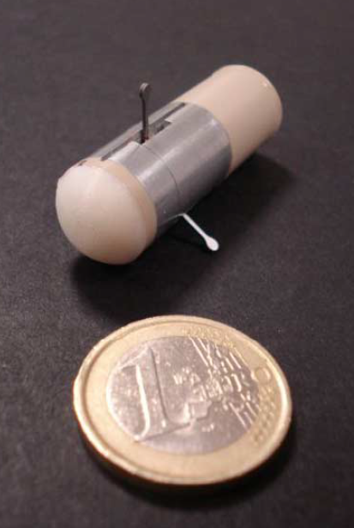


1. Intro
Endoscopic Capsule – solution for active locomotion
Hybrid Locomotion:
Internal actuation mechanisms
External magnetic dragging
Extensively tested in vitro, ex vivo, in vivo

Slide 5
2.1 System Design: Overview
Small Size
Small enough to wallow: 14 x 44mm
Controllability by external magnetic field
Average operating distance: 10cm
Expansion of Tissues
3N at leg tips required to lift collapsed tissue
Real-Time Vision
No vision system currently available (group works on it)
User-Friendly Control Interface
Switching intuitively between locomotion types

Slide 6
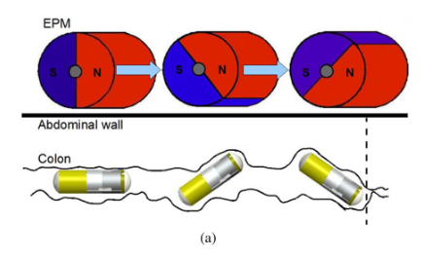
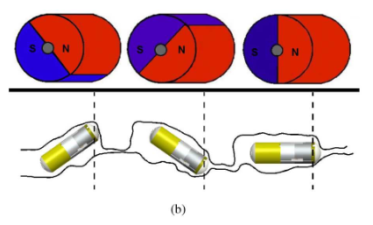
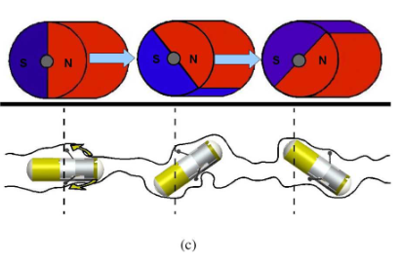
2.1 System Design: Overview
Normal: Magnetic Locomotion
Obstacle: Collapsed Intestine
EPM:
External
Permanent
Magnet
Solution: Deployment of Legs

Slide 7
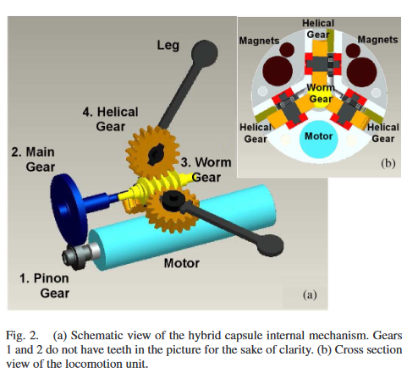
2.2 Internal Mechanism
When capsule is stuck
Electromagnetic Brushless Motor
Interference with permanent magnets
Legs placed radially at 120 degrees

Slide 8
2.2 Internal Mechanism
Steel Worm Gear
Brass Main Gear
Brass Pinion Gear
Use of synthetic ruby: minimizing friction & overall dimensions

Slide 9
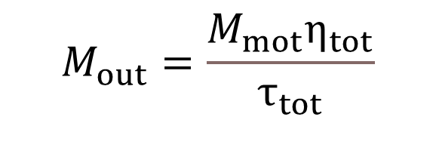
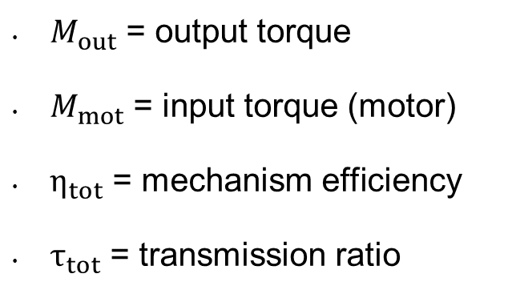
2.2 Internal Mechanism
$$M_{out}=\frac{M_{mot}η_{tot}}{τ_{tot}}$$
$M_{out}$ = output torque
$M_{mot}$ = input torque (motor)
$η_{tot}$ = mechanism efficiency
$τ_{tot}$ = transmission ratio
Torque is the rotational equivalent of Force

Slide 10



2.2 Internal Mechanism
Transmission Ratio = the ratio of the angular velocities of the components
$$τ_{tot}=τ_{12}τ_{23}τ_{34}$$
$\text{“}\text{Reduction}\text{” }\text{or} \text{gear} \text{ratio}= \frac{\text{number} \text{of} \text{teeth} \text{on} \text{the} \text{large} \text{gear}}{\text{number} \text{of} \text{teeth} \text{on} \text{the} \text{small} \text{gear}}$
Mechanical efficiency = effectiveness in transforming the input power to output power
$$η_{tot}=η_{12}η_{23}η_{34}$$

Slide 11
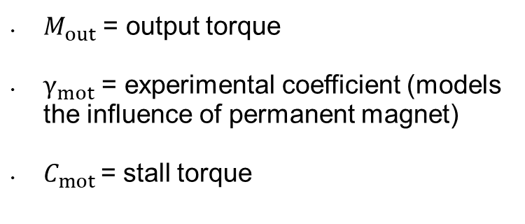
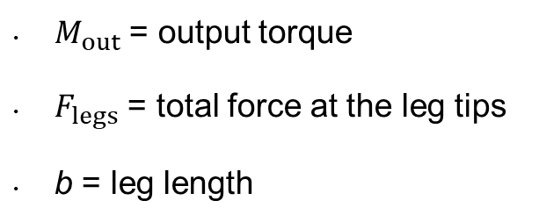


2.2 Internal Mechanism
$$M_{out}=F_{legs}b$$
$$M_{mot}=0.5C_{mot}γ_{mot}$$
$M_{out}$ = output torque
$γ_{mot}$ = experimental coefficient (models the influence of permanent magnet)
$C_{mot}$= stall torque
$M_{out}$ = output torque
$F_{legs}$ = total force at the leg tips
b = leg length
Stall torque (~max torque) → caused by a load that causes the output rotational speed of a device to become zero

Slide 12
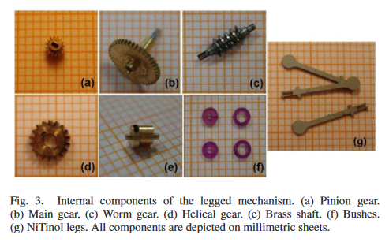


2.2 Internal Mechanism
$$F_{legs}b=\frac{(0.5C_{mot}γ_{mot})(η_{12}η_{23}η_{34})}{τ_{12}τ_{23}τ_{34}}$$
$$F_{legs}=\frac{(0.5C_{mot}γ_{mot})(η_{12}η_{23}η_{34})}{τ_{12}τ_{23}τ_{34}b}$$
Maximum Reduction Ratio
High Efficiency
Small Size
Reliability (mechanism design + materials)
Ease of Fabrication (CNC milling)
Costs

Slide 13
2.3 Magnetic System
Provides external active locomotion
EPM: 1.5 kg, 1.21 T, cylindrical shape (diameter=60mm, length=70mm)
IPM:
6 magnets of φ = 3.175 mm, L =6.35 mm
12 magnets of φ = 1.58 mm, L = 3.175 mm
Notes:
External permanent magnet (EPM)
Internal permanent magnets (IPM)]

Slide 14
2.3 Magnetic System
FEM analyses the distance and magnetic field from the EPM
Operative distance: 6-9 cm
Notes:
Finite-elements method (FEM)
https://www.youtube.com/watch?v=C6X9Ry02mPU
Flux density is the measure of the number of magnetic lines of force per unit of cross-sectional area.

Slide 15
2.4 On-Board Electronics
Diameter of 10.3 mm, thickness of 2.5 mm
Deep sleep modality was also implemented
Rechargeable lithium-ion polymer battery
Battery is in the range of 18h to 25min
Notes:
Four-layer circular electronic board (diameter = 10.3 mm, thickness = 2.5 mm)
(180° leg movement consumes 12 min of autonomy)

Slide 16
2.4 On-Board Electronics
Human-machine interface is compatible with voice commands
Texas Instruments microcontrollers effective for LGI tract telemetry

Slide 17
2.5 Packaging and Assembly
Chassis and body fabricated in aluminum alloy
Cylindrical tank fabricated in polymer PEEK
Composed of 60 different parts
Assembled measures 14mm diameter, 44mm length, weights 13.5g

Slide 18
2.5 Packaging and Assembly
(a) Assembly of worm gear and helical gears in the chassis. (b) Assembly of the motor.
(a) Chassis. (b) Body. (c) Tank. (d) Frontal plug.
(e) Rear plug. (f) Cap.

Slide 19
3. Experimental Validation
Legs pulled with a force of 3.58N

Slide 20
3. Experimental Validation
In vitro, ex vivo, in vivo trials for time estimation
In vitro: 20cm tract of latex colon simulator (Kyoto Kagaku)
Ex vivo: 20cm fresh porcine colon segment
In vivo: 4 female pigs with a weight 25-35 kg
The capsule was observed by a gastroscope

Slide 21
3. Experimental Validation
The magnetic field moves and steers in collapsed regions
The legged mechanism lifts and distend collapsed regions
In vitro < 10 min
Ex vivo < 10 min (7/10 cases)
In vivo 40 cm < 5 min (6/10 cases)
Notes:
The three failed trials were mainly due to the absence of muscular tone

Slide 22
4. Conclusion
Two different solutions for active locomotion merged successfully
Comparison with other locomotion modules is power consumption and speed
Previous prototypes: 4-leg capsule 3 cm/min, 8-leg capsule 4 cm/min, 12-leg capsule 5 cm/min, hybrid capsule 8 cm/min

Slide 23
5. Future work
Miniaturized mechanism
New leg shapes to minimize local tissue stresses
Real-time wireless vision module, not commercially available at the moment of experiments
Developing a 20fps real-time wireless camera system for capsule endoscopy

